Slide 1
EDA: Gramener ANALYSIS

Slide 2
Business Objectives
Identify the driving factors (or driver variables) behind loan default, in order to help the company with its portfolio and risk assessment.

Slide 3
Approach - Data Cleaning
The dataset provided had 111 columns
Started off with Data Cleansing and columns with all null values were removed
Next, Irrelevant Columns (which were informational, but not useful for the purpose of analysis) were removed
Next, All columns which had the same value for all the records were dropped
Next, Unwanted rows were removed. In order to do this, 3 dataframes were created. 1 for Fully Paid, 1 for Current and 1 for Charged Off Records
The final dataframe to be used for further analysis was created using the Fully Paid and Charged Off dataframes. The Current dataframe was excluded as there was no certainty at this point in time, if those records will become Paid up or Charged off at a later time
From this dataframe, 2 more columns 'recoveries’ and 'collection_recovery_fee’ were dropped as they were applicable only for Charged off loans and were only informational in nature

Slide 4
Approach - Data Manipulation
Appropriate rounding-off was done on the amount fields
2 new calculated columns were created - in order to find if the loan amount was funded partially or in full AND if the Funded amount was completely committed by investor or not
A partially funded amount had to be investigated as to why the loan was not completely funded
A partially committed amount subjects the lender to a direct risk in case of a default
Next, Columns where a null value could be replaced by a valid value (0 in this case for pub_rec_bankruptcies ) was done.
Appropriate removal of % etc. were done and data types were converted to the correct data types for the purpose of Analysis

Slide 5
Approach – Data Analysis
Univariate Analysis
The frequency of variables against the complete data set was compared against the data set with Charged off status
A proportion contribution of those variables was calculated to determine if there is a significant inference that could be drawn based on the findings
Wherever relevant, statistical values for numeric variables were observed and plotted through box plots to derive inferences
Bivariate Analysis
Bivariate analysis was conducted on variables pairwise to study the correlation between 2 variables
Bivariate Analysis was conducted only on the Charged Off Dataframe

Slide 6
Approach – Conclusion
Key Drivers Identified
Term : A Higher value of Term has a higher Probability of Default
Interest Rate : A Higher value of Interest Rate has a higher Probability of Default
Relationship between Grade, Sub Grade and Interest Rate: As Grades move from A to G, the Interest Rate increases in that order. Within a Given grade, as the sub Grade moves from 1 to 5 – the Interest Rate also increases in the same order
Annual Income : The highest number of Defaulters are those with a lower Annual Income
dti : If the dti is high, there is a higher probability for the loan to be defaulted
Additionally, Combination variables have been identified as shown in the subsequent slides

Slide 7
Plots for Univariate Analysis

Slide 8
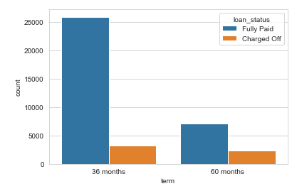
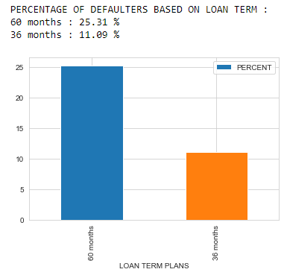
Term

Slide 9
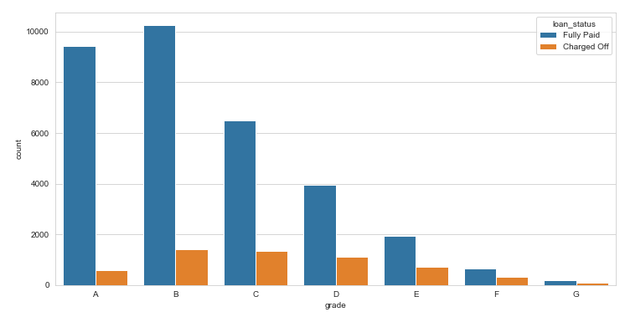
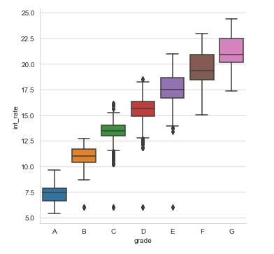
Grade

Slide 10
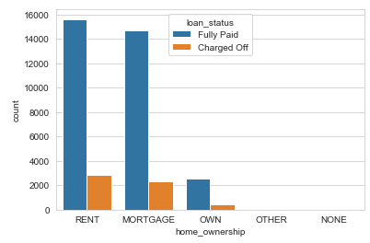
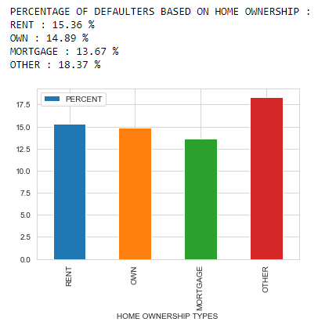
Home Ownership

Slide 11
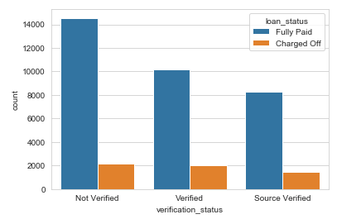
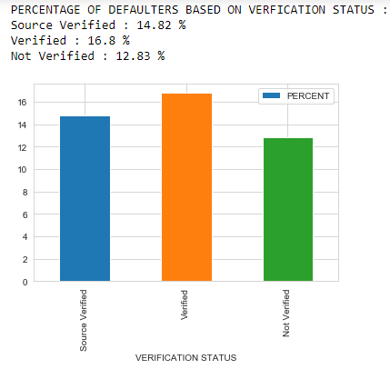
Verification Status

Slide 12
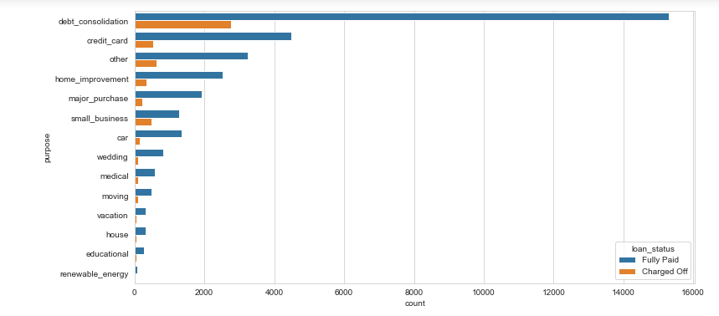
Purpose - 1

Slide 13
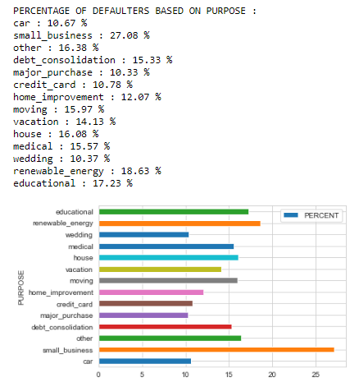
Purpose - 2

Slide 14
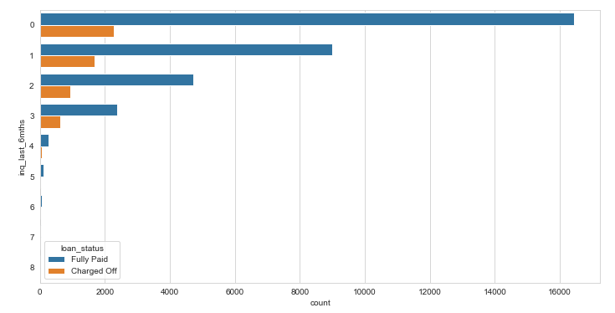
Inq_last_6months

Slide 15
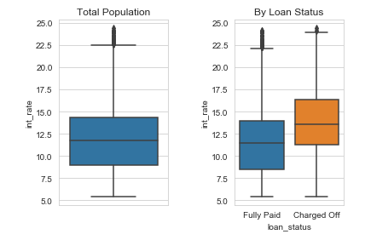
Interest Rate

Slide 16
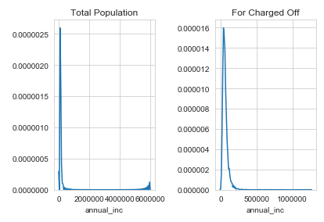
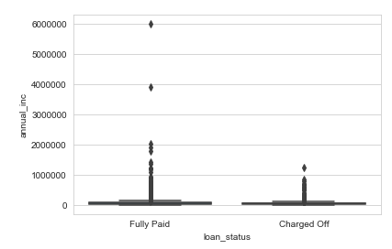
Annual Income

Slide 17
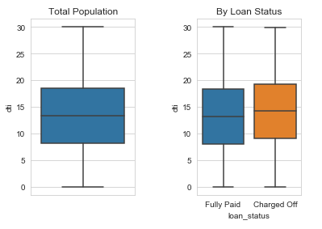
dti

Slide 18
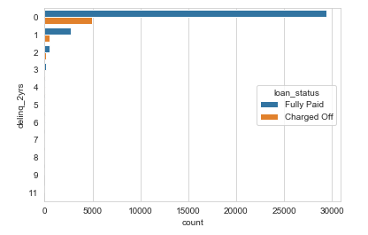
delinq_2yrs

Slide 19
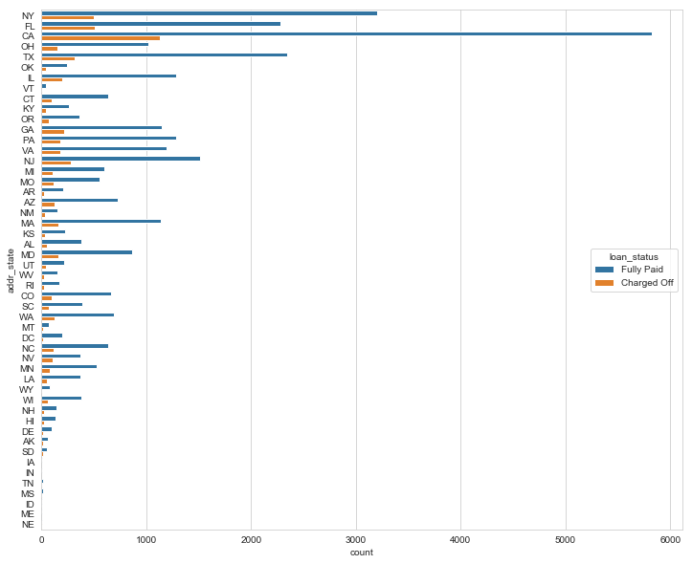
Addr_state

Slide 20
Plots for Bivariate Analysis

Slide 21
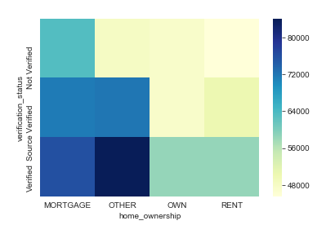
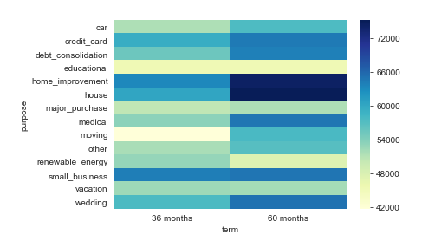
Bivariate Analysis Sample Plots

